Slide 1

CAPSTONE PROJECT
EMPLOYEES PAYROLL IN LOS ANGELES

Slide 2

AGENDA
LEARNING OBJECTIVE
INTRODUCTION​
SOURCE​
DATA MODEL​
MAPPINGS​
WORKFLOW​
SCHEDULERS, PARAMETERS, DEPENDENCY, PMCMD​
DERIVED INSIGHTS​
​
Conduct a short research project to answer a question, drawing on several sources and generating additional related, focused questions that allow for multiple avenues of exploration.

Slide 3
INTRODUCTION
This project focuses on creating a data warehouse from a flat file source to manage payroll data for Los Angeles employees. The aim is to streamline data by reducing redundancy and enhancing its accuracy. The data is organized into fact and dimension tables for easier analysis.

Slide 4
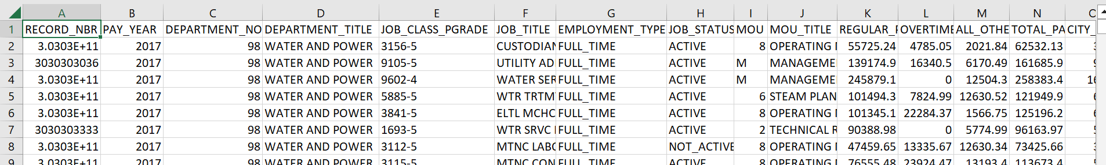
SOURCES
THIS DATASET CONTAINS EMPLOYEE PAYROLL INFORMATION FOR VARIOUS
DEPARTMENTS AND JOB TITLES WITHIN AN ORGANIZATION.

Slide 5
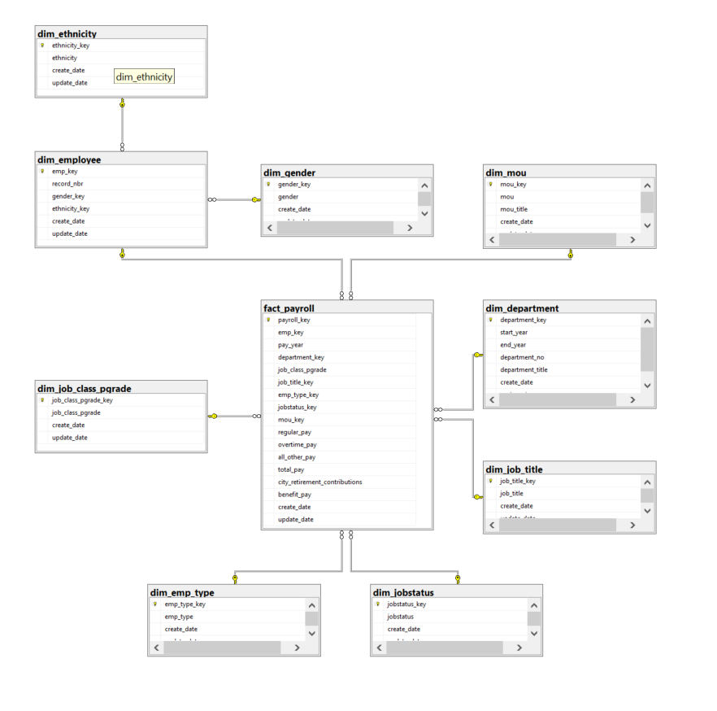

DATA WAREHOUSE DATA MODEL​

Slide 6
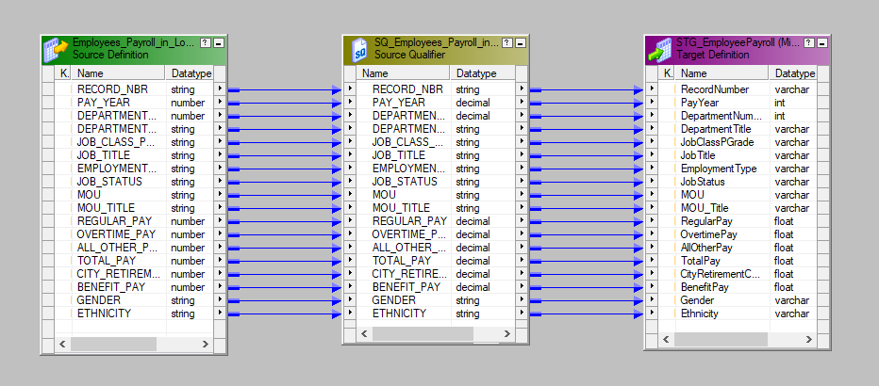
STAGINGS-​Data load

Slide 7
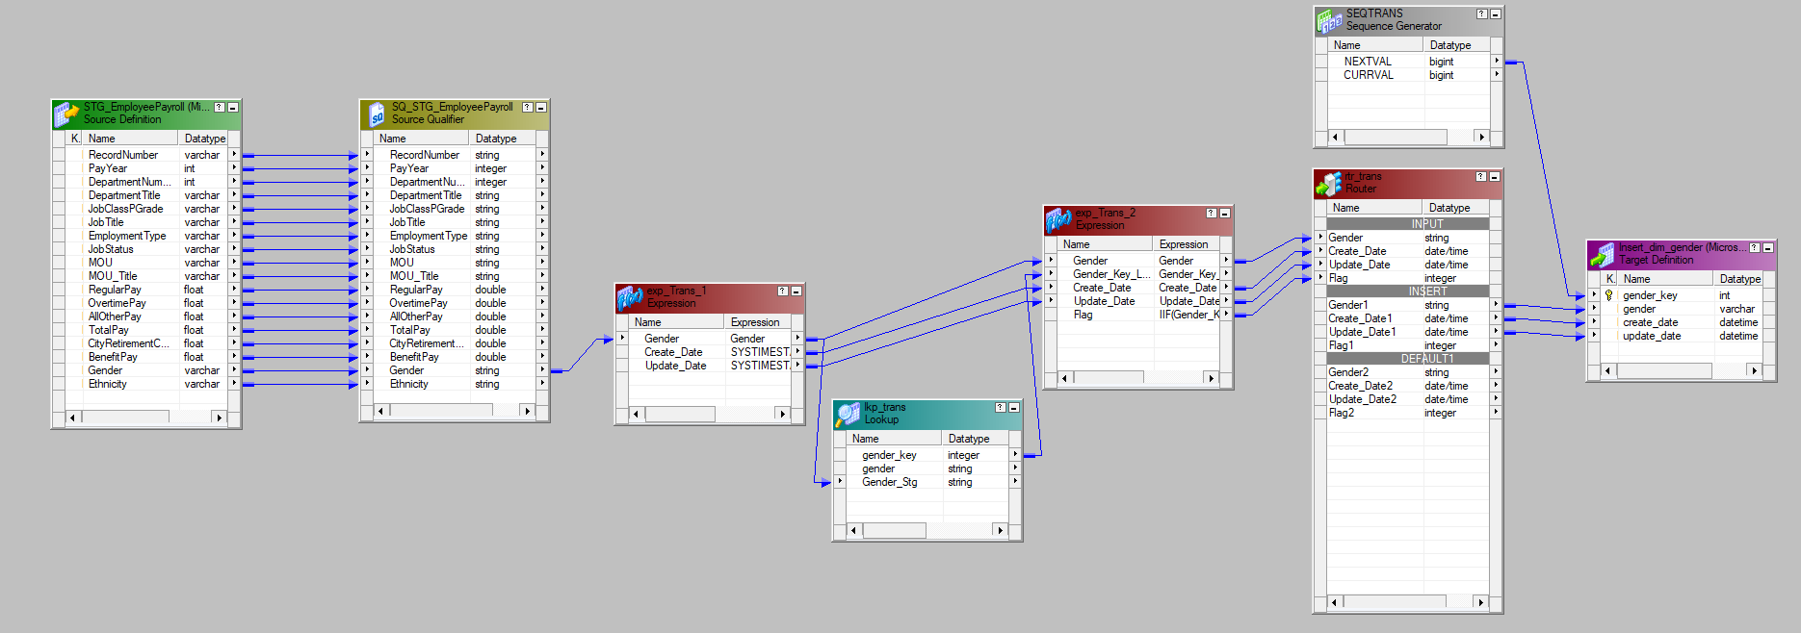
DIMENSIONS - DIM_GENDER

Slide 8
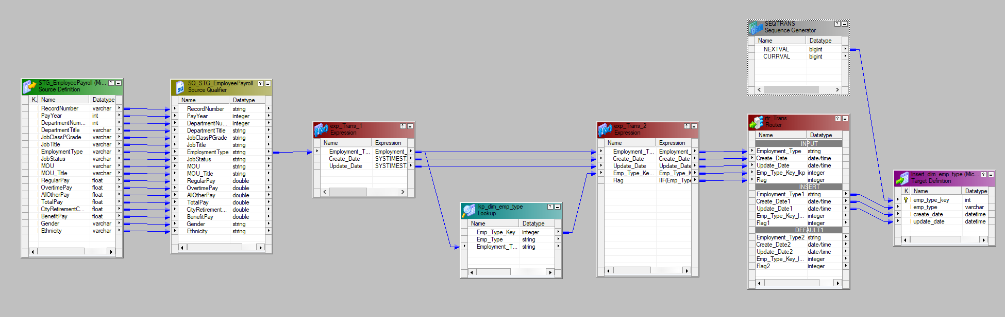
DIMENSIONS - DIM_EMP_TYPE

Slide 9
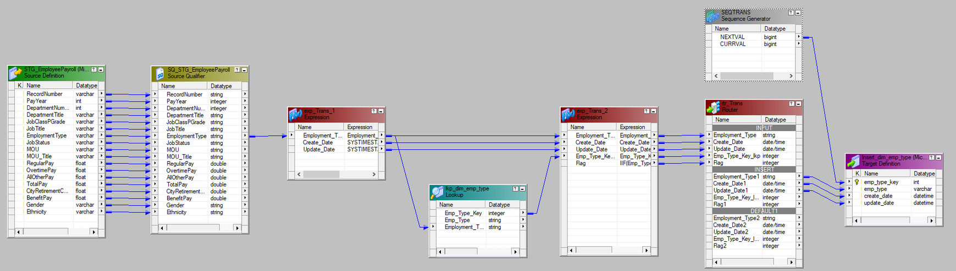
DIMENSIONS - DIM_ETHNICITY

Slide 10
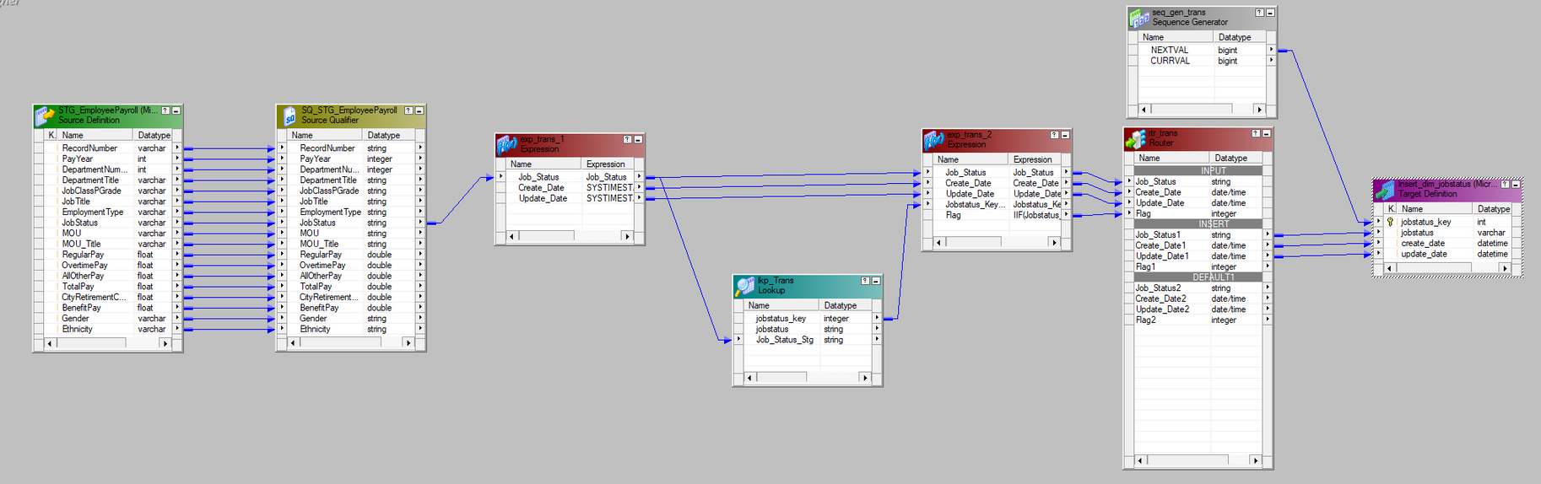
DIMENSIONS - DIM_JOBSTATUS

Slide 11
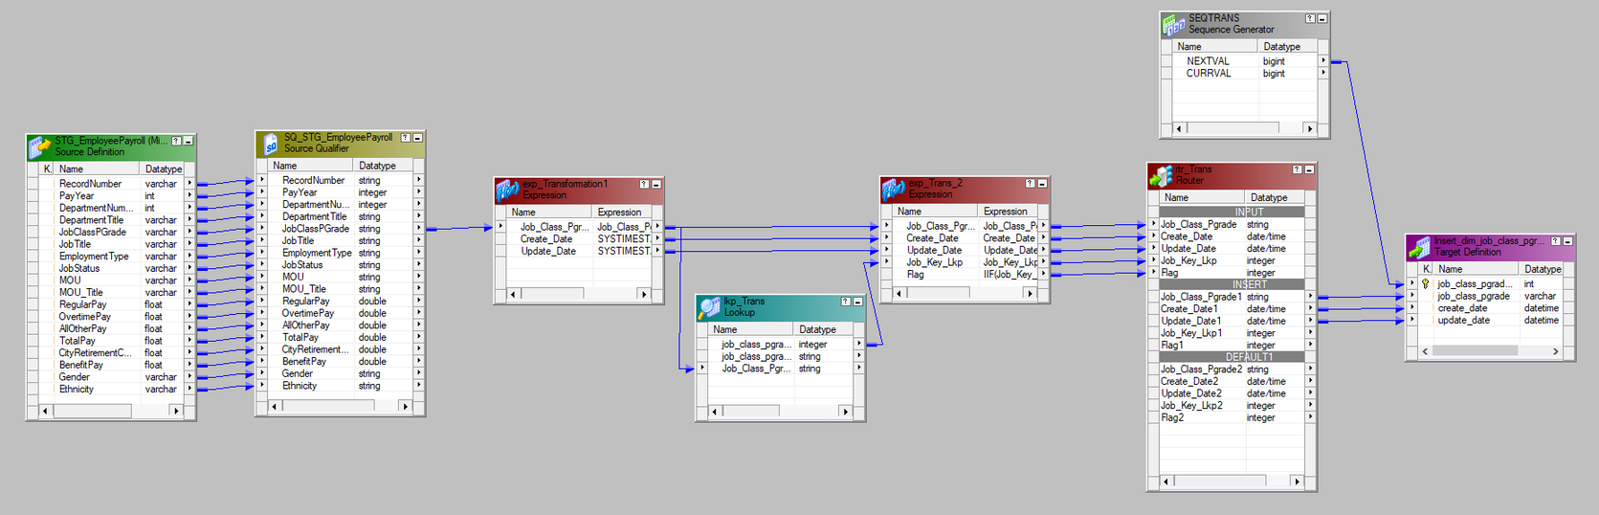
DIMENSIONS - DIM_JOB_CLASS_PGRADE

Slide 12
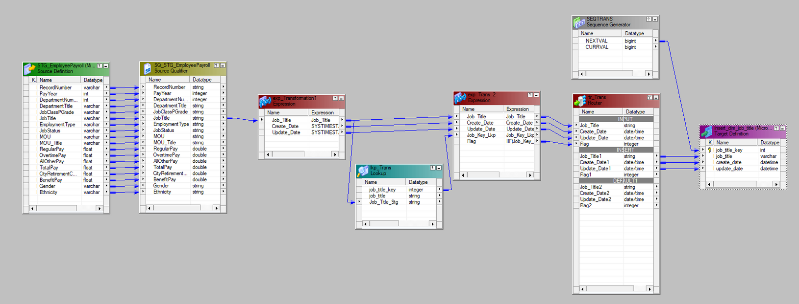
DIMENSIONS - DIM_JOB_TITLE

Slide 13
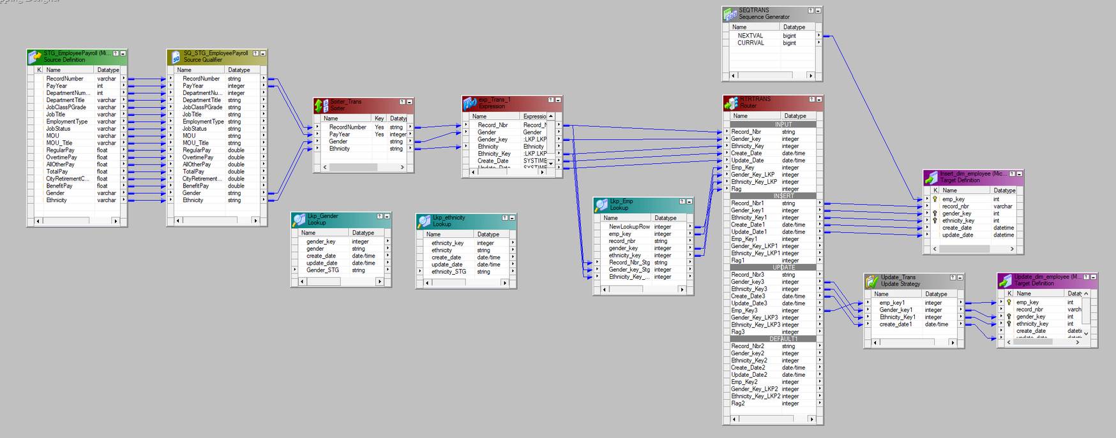
DIMENSIONS - DIM_EMPLOYEE

Slide 14
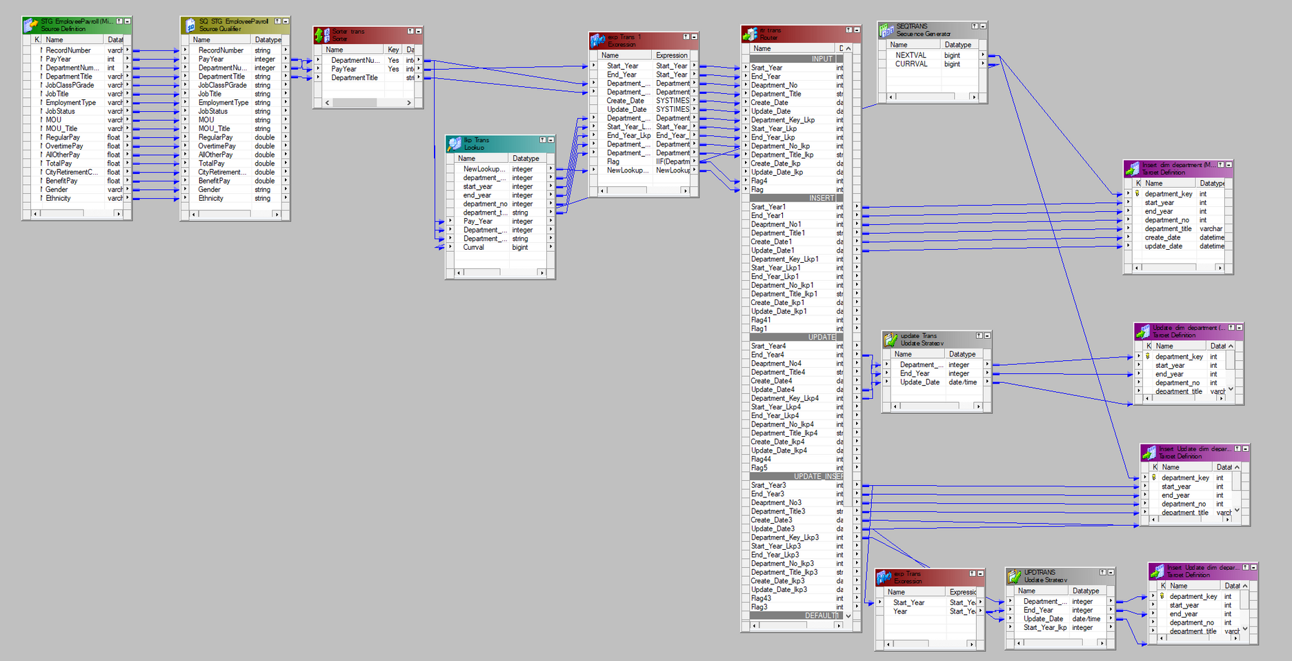
DIMENSIONS - DIM_DEPARTMENT

Slide 15
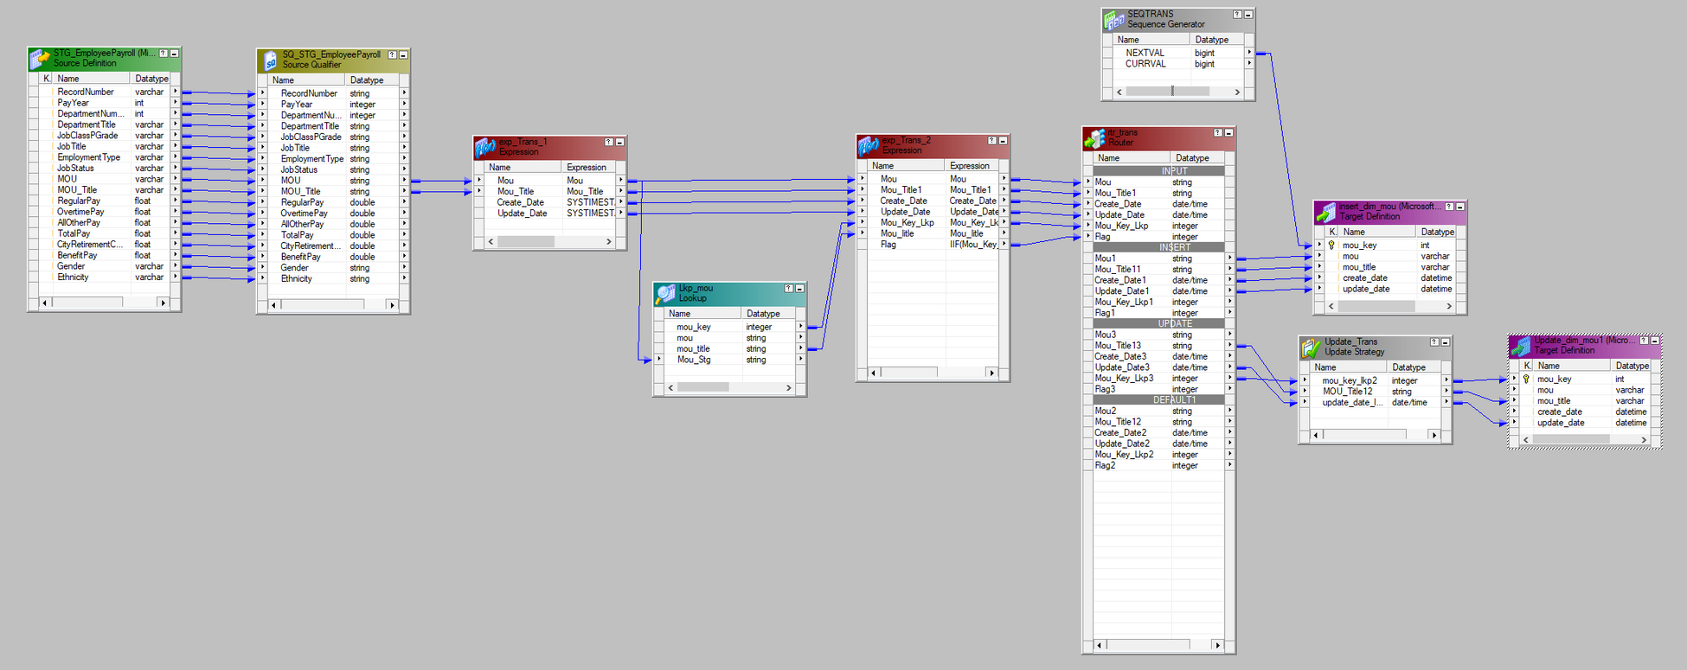
DIMENSIONS - DIM_MOU

Slide 16
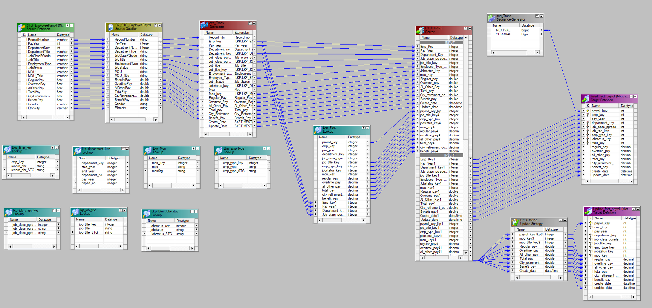
FACT MAPPING​

Slide 17
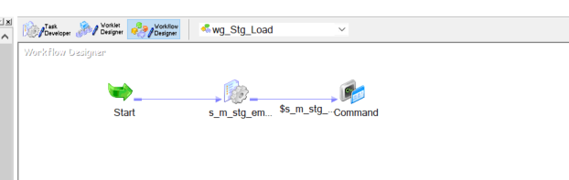
WORKFLOW-​ wf_staging​

Slide 18
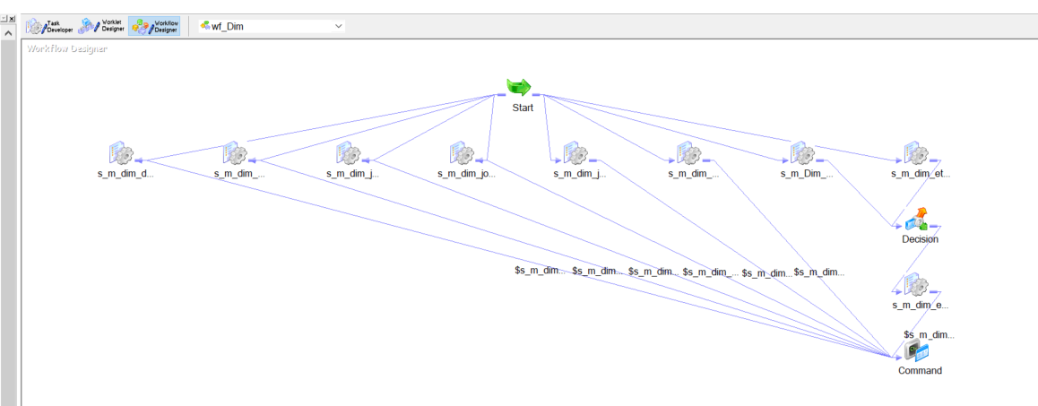
WORKFLOW-​ wf_Dim

Slide 19
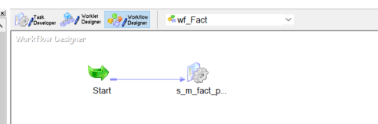
WORKFLOW-​ wf_fact

Slide 20
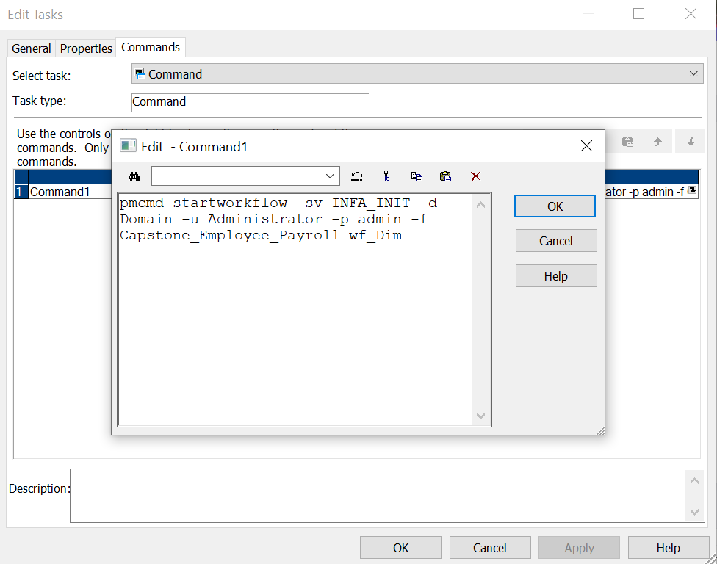
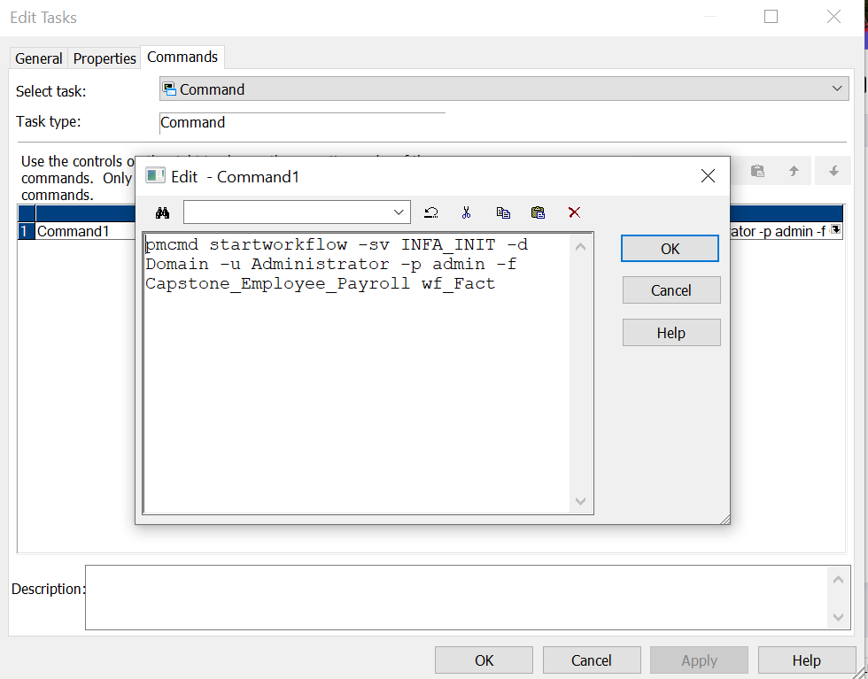
PMCMD

Slide 21
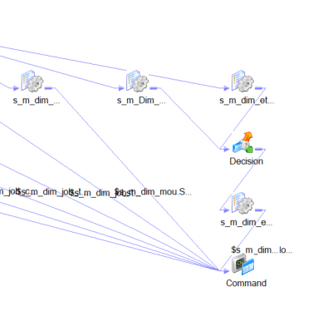
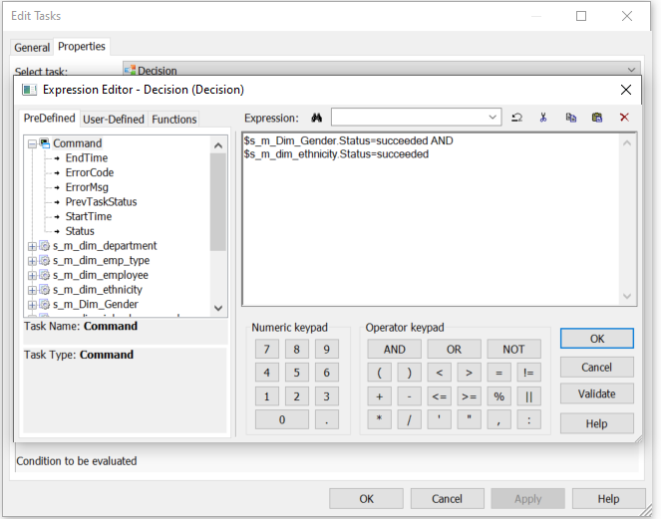
DEPENDENCY

Slide 22
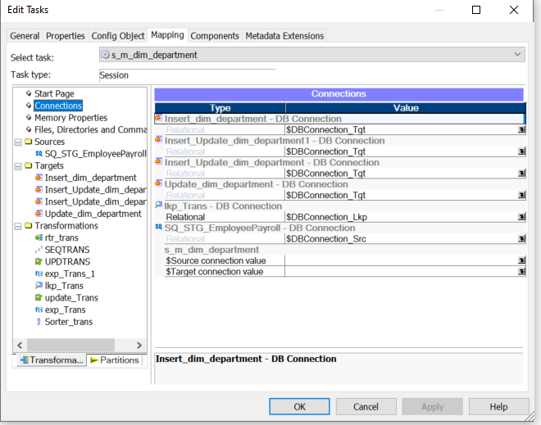
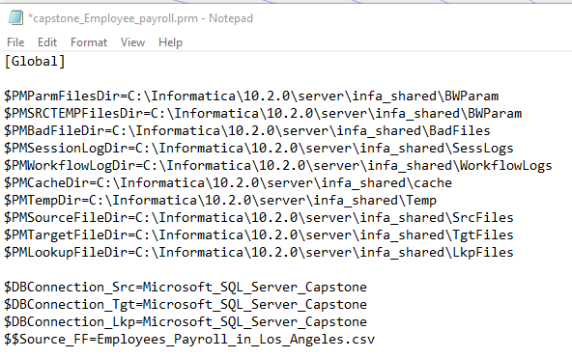
PARAMETERIZATION

Slide 23
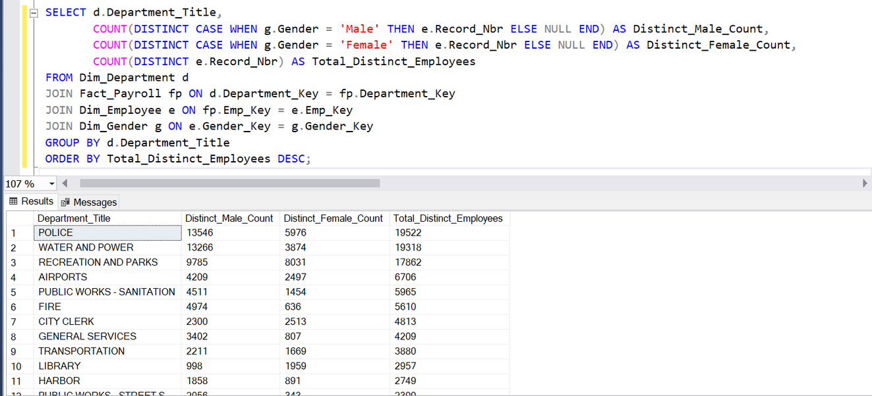
DERIVED INSIGHTS-I​
TO CALCULATE GENDER DIVERSITY WITHIN DEPARTMENTS

Slide 24
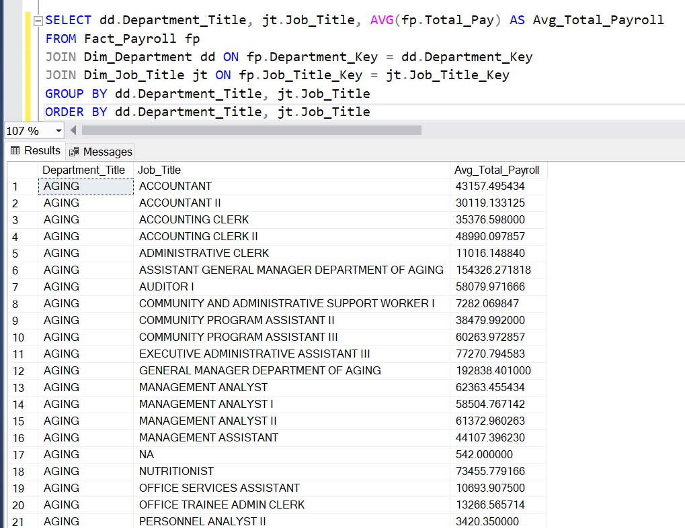
DERIVED INSIGHTS-I​I
THIS QUERY CALCULATES THE AVERAGE TOTAL PAY FOR EMPLOYEES, CATEGORIZED BY DEPARTMENT AND JOB TITLE, PROVIDING INSIGHTS INTO HOW PAY IS DISTRIBUTED ACROSS DIFFERENT ROLES IN THE ORGANIZATION.

Slide 25
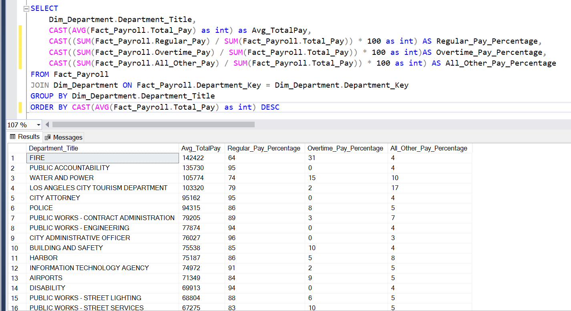
DERIVED INSIGHTS-I​II
QUERY PROVIDES A BREAKDOWN OF THE PAYROLL SUMMARY FOR EACH DEPARTMENT IN PERCENTAGES.

Slide 26
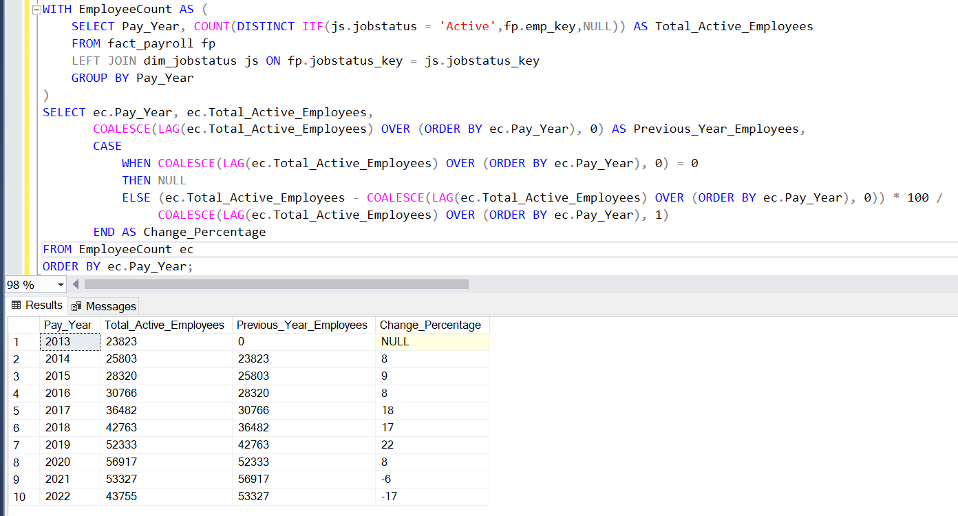
DERIVED INSIGHTS-I​V
THIS QUERY TRACKS THE NUMBER OF ACTIVE EMPLOYEES IN EACH YEAR, SHOWING HOW THE WORKFORCE CHANGES OVER TIME.

Slide 27
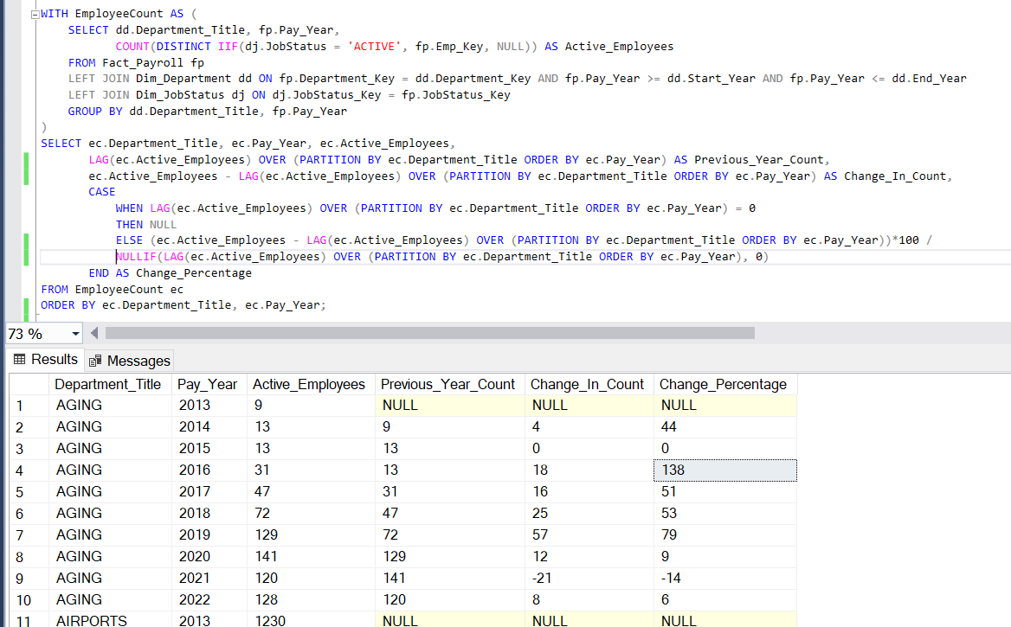
DERIVED INSIGHTS-V
THIS QUERY CALCULATES THE NUMBER OF ACTIVE EMPLOYEES IN EACH DEPARTMENT AND YEAR, AND THEN SHOWS HOW THIS NUMBER CHANGES FROM ONE YEAR TO THE NEXT.

Slide 28
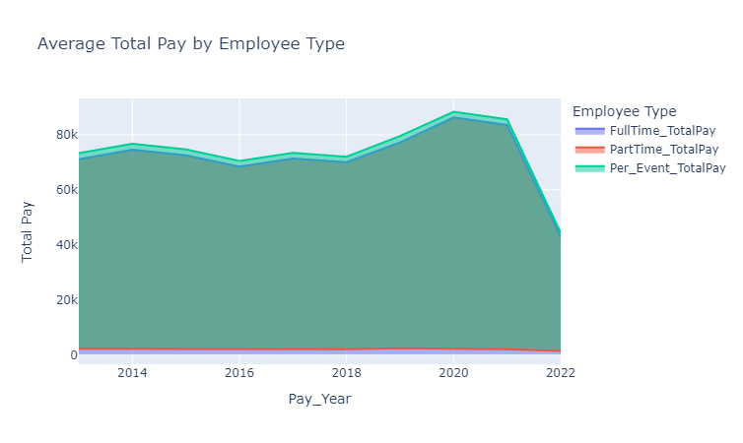
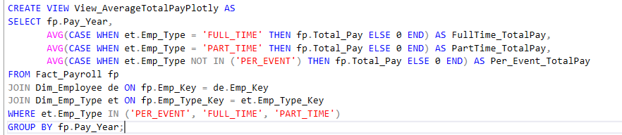
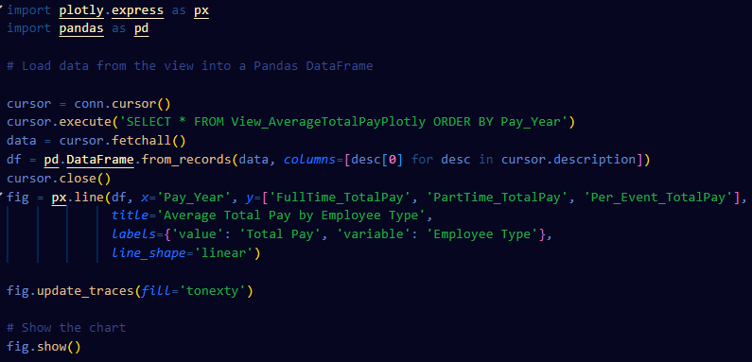
GRAPH
AVERAGE TOTAL PAY BY EMPLOYEE TYPE

Slide 29
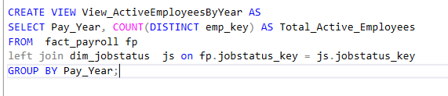
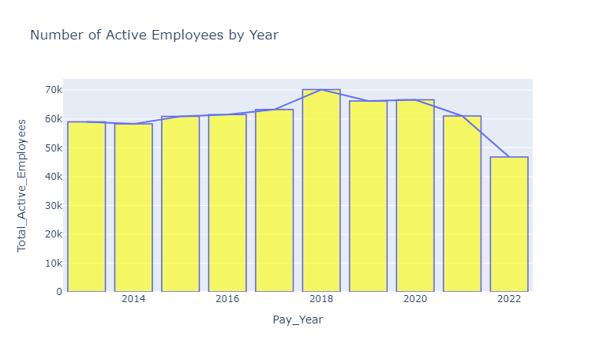
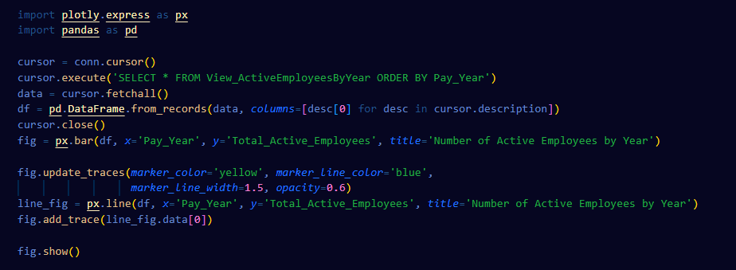
NUMBER OF ACTIVE EMPLOYEES BY YEAR
GRAPH

Slide 30
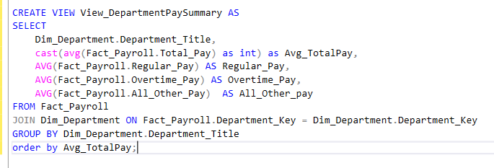
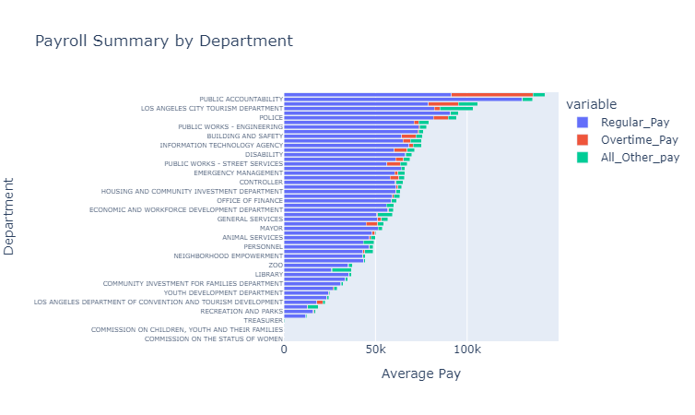
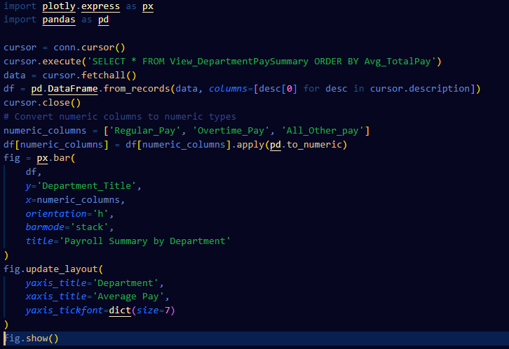
GRAPH
PAYROLL SUMMARY BY DEPARTMEN

Slide 31
CHANDRA KIRAN
THANK YOU!

